Slide 1
INTERNATIONAL COMMUNITIES OF POSTGRADUATE LEARNING: A CASE STUDY OF THE UNIVERSITY OF LIVERPOOL'S ON-LINE PROFESSIONAL DOCTORATE IN EDUCATION'
HETL Conference Tuesday 15th January 2013 Session F2
Notes:
This slide could be on display whilst we welcome folk

Slide 2
Professor Clare Pickles Director of Online Studies, EdD Dr. Kathleen Kelm EdD Faculty and Director of the Centre for Faculty Excellence
Notes:
Introduce ourselves . Do edit their title etc

Slide 3
The University of Liverpool
The original ‘Red Brick University’ with a history dating back to 1881 with a Royal Charter awarded in 1903
Worldwide reputation for excellence and an Alma Mater of 10 Nobel Prize Winners
A member of the Russell Group of UK research-led universities
Internationally recognised research: Top 10 in UK for research income
Largest provider of 100% online postgraduate degrees in Europe
Degrees are designed by colleagues in departments at the University of Liverpool.
In partnership with Laureate Online Education since 1999
Notes:
Summary of the University of Liverpool

Slide 4
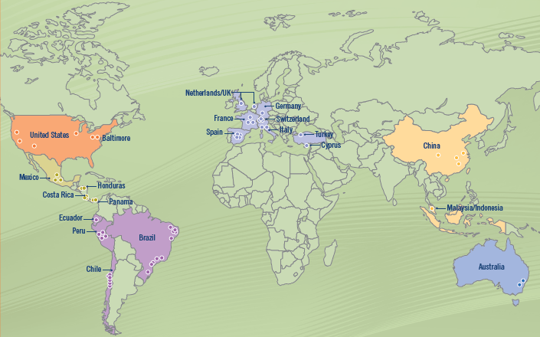
Laureate International Universities
Laureate International Universities
28 countries • More than 57 institutions • More than 600,000 students
Notes:
Overview of the scale of the online programmes

Slide 5
The University of Liverpool offers over 40 online postgraduate degrees within each subject listed:
Management (DBA, MBA, MSc)
Information Technology (MSc)
Law
(LLM)
Health
(MPH & MSc)
Psychology (MSc)
Education
(EdD)
Notes:
Where the EdD fits into the scheme

Slide 6
For future leaders in education
Integrated, holistic approach
Higher Education in
global context
Universities as places of learning and learning institutions
EdD programme
Notes:
Emphasis on the international community of students and faculty

Slide 7
Students decide when to work on their weekly assignments in our 24/7 classroom
Incorporate their degree into their existing responsibilities
Structured weekly deadlines for continued interaction.
Balance work, study and family - fit around both personal and professional life.
Framework designed to encourage progress and build and keep momentum
Flexibility
Structure
Time
Global
Tutors
Notes:
discuss the points relating to flexibility as outlined on the slide.

Slide 8
Student Readiness Orientation to acquaint Students with the online learning environment
Introduction to become further acquainted with the expectations before the courses start in earnest
Nine modules followed by a Thesis
Thesis is on a topic of their choice with a personal Thesis supervisor who is an expert in their chosen field
Flexibility
Structure
Time
Global
Tutors

Slide 9
Weekly time commitment of +/- 20 hours
Assignments are due each weekend, and each Wednesday
Asynchronous classroom so Students never have to be online at a specific time
No lengthy exams to take up their time, grades come from submitted class work
Assignments are due at midnight local time
Flexibility
Structure
Time
Global
Tutors

Slide 10
Gain new skills and knowledge in their industry and gain confidence and discipline while enhancing their own personal progress
Fellow students are working professionals who constantly challenge and expand their ideas
Programmes are built around real-world issues and expose Students to different cultures and communication styles
Flexibility
Structure
Time
Global
Tutors

Slide 11
Tutors have years of industry experience as well as being educated to advanced postgraduate level
Tutors are all highly trained and qualified in the online teaching environment
Facilitate class discussion and provide feedback and assistance
Flexibility
Structure
Time
Global
Tutors
Notes:
discuss the points relating to the Global nature of the classroom as outlined on the slide.
All Tutors are recognized teachers of the University.
Tutors have years of industry experience as well as being educated to doctoral level

Slide 12
Continuous personal support throughout the duration of the studies:
Enrolment
Preparation
Module Study
Thesis
Graduation
Enrolment Advisor
Student Support Manager
Doctoral Tutors
DDP* Mentors
Thesis Advisor
Student Support Manager
Alumni Relations Manager
*Doctoral Development Plan
Support from staff and peers as well as continuous IT and Library assistance
Notes:
So this is where we are so far, with excellent support for our students. How do we continue that support into the Thesis stage to develop an international on line graduate community?

Slide 13
Where are we now?
Aim:
To create an International on-line graduate community to support professional doctoral students.
Objectives:
To provide an equivalent student experience compared to student members of the on-campus Graduate School
To develop a Community of Research and Community of Practitioners
To enable students to create a professional network community both throughout and beyond the Thesis phase.

Slide 14
Professional Community
Campus Community
Faculty Community
Doctoral Community
Doctoral Alumni Community
MOD
MC
DDP
F2F
Thesis
Communication
Centre

Slide 15
Journey within Community
Community of Inquiry
Research
Community of Practice
Transformative
Student
Faculty
Student
Practitioner
Action
Exclusive Membership

Slide 16
Thank you and…
Contact Information:
Clare.Pickles@ohecampus.com
Kathleen.Kelm@my.ohecampus.com

