Slide 1
International HETL 2013 Conference
Wikis: An Experiential Learning Tool to Engage Students in Undergraduate and Graduate Courses
Dr. Michael J.D. Sutton
msutton@westminstercollege.edu
michaeljdsutton@gmail.com
Blog: http://michaeljdsutton.net
Website: www.linkedin.com/in/michaeljdsutton/
Copyright © 2013 Michael JD Sutton
No part of this presentation may be reproduced without the permission of the author.

Slide 2
Intellectual Property Statement (1)
This presentation is Copyright © 2013, Michael JD Sutton
No part of this presentation (document) may be reproduced, stored in a retrieval system, or transmitted, in any form or by any means, electronic, mechanical, photocopying, recording, or otherwise, without the prior written permission of Dr. Michael JD Sutton.
These PowerPoint Presentation Slides were made available exclusively to attendees of the Annual HETL 2013 Conference, Orlando, FL. Under copyright law, Dr. Sutton is granting you fair use of a copy of this document for your personal files.
Blog: http://michaeljdsutton.net
Website: www.linkedin.com/in/michaeljdsutton/

Slide 3
Intellectual Property Statement (2)
Under no circumstances may portions of this material be used for, or incorporated into, your own reports, presentations, workshops or seminars without obtaining written attribution to Dr. Michael JD Sutton.
Historically, Dr. Sutton has not withheld consent to incorporate or use specific portions of this material to a reasonable requester. Dr. Sutton only asks that the following conditions be met for attribution:
1) appropriate attribution on the presentation slide or report, i.e., “Sutton, Michael. (2013). Wikis: An Experiential Learning Tool to Engage Students in Undergraduate and Graduate Courses. International HETL Annual Conference, Orlando, FL” and,
2) you purchase Starbucks $5 gift card and send to Dr. Sutton J.

Slide 4
Goal of the Literature Review [1]
Explore a wide range of existing references within the existing body of international literature emerging through multidisciplinary and cross-disciplinary sources
Purpose:
initial attempt to frame the new interdisciplinary educational field by analyzing emerging literature from many different disciplines, sub-disciplines, and fields of study.

Slide 5
Goal of the Literature Review [2]
~500 references were originally identified, retrieved, and reviewed
Consensus on the impact of wikis appeared to be positive.
Evidence provided in a minority of cases, studies, and course descriptions were inconsistent or did not reinforce the strengths of wiki tools in learning environments.
Emergent body of knowledge associated with wikis in HE appeared predominantly focused upon the experiences and learning outcomes of learners.
Answering the question of “how educators integrate wikis appropriately in formal education” appeared contradictory.

Slide 6
Sampling Method
Encompassed the review primary and secondary research material
Coverage was international and consisted of English language material

Slide 7
Method
Illuminative evaluation (Parlett & Hamilton, 1972), using document analysis method
Used descriptive & interpretative methods

Slide 8
Search Strategy
Initially Google Scholar and Google
Subsequently, online academic sources were searched in-depth

Slide 9
Search Strategy [2]
Keywords encompassing a structured combination of the search terms:
classroom
collaboration
education
higher education
learning
student
teaching
wiki
Within the title or abstract:
> 75% contained 3 of the search terms as co-located words
> 90% contained 2 of the search terms as co-located words

Slide 10
Characteristics of Exemplary Cases
Yin (1994) outlined five characteristics of exemplary case studies:
significance,
completeness,
consideration of alternative perspectives,
reporting of sufficient evidence, and
an engaging composition
Characteristics used to explore exemplary cases

Slide 11
Reported Results/Outcomes from Cases
Learner engagement with wikis provided significant opportunities for:
self‐representation,
personal reflection, and
additional instances of organized forms of collaboration and knowledge construction.
Content is often remixed, repurposed, and regenerated into more refined knowledge nuggets through collaborative activities creating “network effects through an ‘architecture of participation,’ and going beyond the page metaphor of Web 1.0 to deliver rich user experiences”
—O'Reilly (2005)

Slide 12
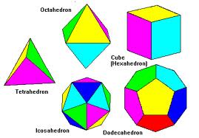
Proposed Wiki Typology
Phillipson (2008) proposed a typology to describe different kinds of wikis within HE:
resource wiki — repository to collect a collaborative knowledgebase of wide ranging topics for learner access
presentation wiki — discussion forum for learner knowledge nuggets
gateway wiki — data repository for static information
simulation wiki — foundation for constructing narrative paths and decision-making
illuminated wiki — corpus of material that tightly integrated original material with the discussion and comments, based upon the actual wiki structure

Slide 13
Learning Theories & Frameworks
Vast majority of the educational frameworks to assess learning were personal perspectives
What Didn’t We Find!
Consistent Framework to evaluate and assess the impact of the wiki on learners was lacking

Slide 14
Suggested Journal Sources for Wikis in Education [1]
Academy of Management Learning and Education
American Educational Research Journal
American Journal of Distance Education
Australasian Journal of Educational Technology
British Journal of Educational Technology
Canadian Journal of Learning and Technology
Communications of the Association for Information Systems
Computers & Education
E-learning
Electronic Journal of e-Learning
European Journal of Open, Distance and Elearning
Innovate Journal of Online Education
Innovative Higher Education
Interactive Learning Environments
Interdisciplinary Journal of Knowledge and Learning Objects

Slide 15
Suggested Journal Sources for Wikis in Education [2]
International Journal of Knowledge Society Research
International Journal of Learning
International Journal of Web-based Learning and Teaching Technologies
International Journal on E-Learning
Internet and Higher Education
Journal of Asynchronous Learning Networks
Journal of Computer-Mediated Communication
Journal of Distance Education
Journal of Educational Computing Research
Journal of Information Systems Education
Journal of Information Technology Education
Journal of Interactive Learning Research
Journal of Interactive Media in Education
Journal of the Learning Sciences
Language Learning and Technology
Online Information Review

Slide 16
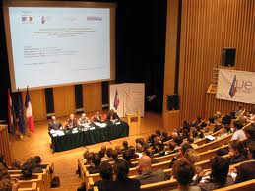
Suggested Proceedings Sources for Wikis in Education
Annual Conference on Teaching and Learning
Annual Meeting of the American Educational Research Association
Annual Sloan-C International Conferences on Online Learning
Proceedings of the Distance Learning Research Conferences
Proceedings of the Canadian Network for Innovation in Education (CNIE) Annual Conferences
Proceedings of ascilite (Australian Society for Computers in Learning in Tertiary Education) Conferences
Proceedings of the IEEE International Conferences on Advanced Learning Technologies
Proceedings of the International Symposia on Computers in Education
Proceedings of the American Society for Engineering Conferences
Proceedings of the Annual International Symposia on Wikis (WikiSym)
Proceedings of the Annual Conference of the Higher Education Academy
Proceedings of the International Conferences on Computers and Advanced Technology in Education (IASTED)
Proceedings of the Information Systems Educators Conferences (ISECON)
Proceedings of the International Conferences on the Learning Sciences

Slide 17
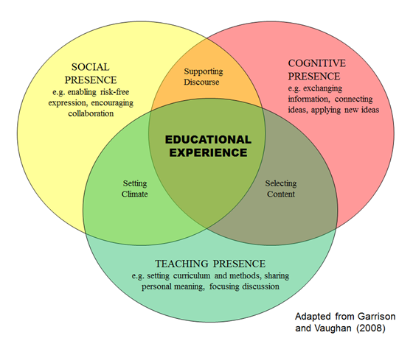
Future Proposal for Consistency of Evaluation
Garrison, D. R., & Vaughan, N. (2008). Blended learning in higher education. San Francisco: Jossey-Bass.
“A Community of Inquiry provides the environment in which students can take responsibility and control of their learning through negotiating meaning, diagnosing misconceptions, and challenging accepted beliefs—essential ingredients for deep and meaningful learning outcomes.”
—Garrison & Anderson (2003). E-Learning in the 21st Century.

Slide 18
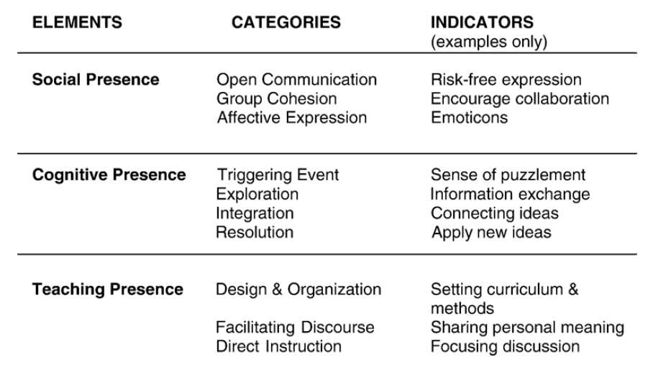
Detailed CoI Elements, Categories, & Indicators
From: Garrison, D. R., & Arbaugh, J. B. (2007). Researching the community of inquiry framework: Review, issues, and future directions. The Internet and Higher Education, 10(3), 157-172.

Slide 19
CoI Study Outcomes…(so far) [1]
“…cognitive presence and teaching presence were important factors in influencing student learning and satisfaction. On the other hand, social presence had no impact on learning but was associated with satisfaction.”
“social presence may well have more influence in … online learning where students are new to this medium.”
—Akyol & Garrison (2008)

Slide 20
CoI Study Outcomes…(so far) [2]
“Balancing socio-emotional interaction, building group cohesion and facilitating and modeling respectful critical discourse is essential for productive inquiry … As important as social presence may be, a community of inquiry is associated with a sense of common purpose and cognitive presence.”
—Garrison (2007)

Slide 21
CoI Study Outcomes…(so far) [3]
“instructor immediacy [i.e., teaching presence] was more predictive of effective and cognitive learning” than “whether students felt close to each other.”
—Baker (2003)

Slide 22
CoI Study Outcomes…(so far) [4]
“A community of inquiry needs to have clear expectations as to the nature of critical discourse and their postings.
Participants need to be aware of the academic objectives, the phases of inquiry, and the level of discourse.
These educational challenges raise the importance and role of teaching presence.
The distinction between facilitation and direction must also be clear from a design perspective.
Teaching presence must consider the dual role of both moderating and shaping the direction of the discourse.”
—Garrison (2007)

Slide 23
CoI Study Outcomes…(so far) [5]
“We strongly encourage management education scholars to further utilize the CoI framework in other on-line and blended-learning investigations, given its vast potential to explain distance learning phenomena … in wiki environments, as in face-to-face environments, the instructor continues to be the significant determinant of successful student learning.
—Daspit & D'Souza (2012)

Slide 24
Significant CoI References [1]
Akyol, Z., & Garrison, D. R. (2008). The development of a community of inquiry over time in an online course: Understanding the progression and integration of social, cognitive and teaching presence.Journal of Asynchronous Learning Networks, 12(2-3), 3-23.
Akyol, Z., Vaughan, N., & Garrison, D. R. (2011). The impact of course duration on the development of a community of inquiry. Interactive Learning Environments, 19(3), 231-246. Anderson, T., Rourke, L., Garrison, D. R., & Archer, W. (2001). Assessing teaching presence in computer conferencing context. Journal of Asynchronous Learning Networks, 5(2), 1-17.
Arbaugh, J.B. (2007). An empirical verification of the community of inquiry framework. Journal of Asynchronous Learning Networks, 11(1), 73-84.
Arbaugh, J. B. (2008). Does the community of inquiry framework predict outcomes in online MBA courses? The International Review of Research in Open and Distance Learning, 9(2). Retrieved from http://www.irrodl.org/index.php/irrodl/article/view/490/1045
Arbaugh, J.B., & Hwang, A. (2006). Does “teaching presence” exist in online MBA courses? The Internet and Higher Education, 9(1), 9-21.
Arbaugh, J.B., Cleveland-Innes, M., Diaz, S.R., Garrison, D.R., Ice, P., Richardson, J.C., & Swan, K.P. (2008). Developing a community of inquiry instrument: Testing a measure of the community of inquiry framework using a multi-institutional sample. The Internet and Higher Education, 11(3-4), 133-136.
Baker, J. (2003). Instructor immediacy increases student enjoyment, perception of learning. Online Classroom, September.
Daspit, J., & D'Souza, D. (2012). Using the Community of Inquiry Framework to Introduce Wiki Environments in Blended Learning Pedagogies: Evidence from a Business Capstone Course. Academy of Management Learning & Education.

Slide 25
Significant CoI References [2]
Shea, P. (2006). A study of students’ sense of learning community in online environments. Journal of Asynchronous Learning Networks, 10(1), 35-44.
Shea, P., & Bidjerano, T. (2009). Community of inquiry as a theoretical framework to foster “epistemic engagement” and “cognitive presence” in online education. Computers & Education, 52(3), 543-553.
Shea, P., Li, C.S., & Pickett, A. (2006). A study of teaching presence and student sense of learning community in fully online and web-enhanced college courses. The Internet and Higher Education, 9(3), 175-190.
Shea, P.J., Pickett, A.M., & Pelz, W.E. (2003). A follow-up investigation of “teaching presence” in the Suny Learning Network. Journal of Asynchronous Learning Networks, 7(2), 61-80.
Garrison, D. R. (2009). Communities of inquiry in online learning: Social, teaching and cognitive presence. In C. Howard et al. (Eds.), Encyclopedia of distance and online learning (2nd ed., pp. 352-355). Hershey, PA: IGI Global.
Garrison, D. R. (2007). Online community of inquiry review: Social, cognitive, and teaching presence issues. Journal of Asynchronous Learning Networks,11(1), 61-72.
Garrison, D.R., & Anderson, T. (2003). E-Learning in the 21st century: A framework for research and practice. London: Routledge/Falmer.
Garrison, D.R., & Arbaugh, J.B. (2007). Researching the community of inquiry framework: Review, issues, and future directions. The Internet and Higher Education, 10(3), 157-172.

Slide 26
Significant CoI References [3]
Garrison, D.R., & Cleveland-Innes, M. (2005). Facilitating cognitive presence in online learning: Interaction is not enough. The American Journal of Distance Education, 19(3), 133-148.
Garrison, D.R., & Kanuka, H. (2004). Blended learning: Uncovering its transformative potential in higher education. The Internet and Higher Education, 7(2), 95–105.
Garrison, D. R., & Vaughan, N. (2008). Blended learning in higher education. San Francisco: Jossey-Bass. Garrison, D.R., Anderson, T., & Archer, W. (2000). Critical inquiry in a text-based environment: Computer conferencing in higher education. The Internet and Higher Education, 2(2-3), 87-105.
Garrison, D. R., Anderson, T., Archer, W. (2001). Critical thinking, cognitive presence, and computer conferencing in distance education. American Journal of Distance Education, 15(1).
Garrison, D. R., Cleveland-Innes, M., Koole, M., & Kappelman, J. (2006). Revisting methodological issues in the analysis of transcripts: Negotiated coding and reliability. The Internet and Higher Education, 9(1), 1-8.

