Slide 1
International HETL 2013 Conference
Wikis and Blogs as Core Technology for Increasing Classroom Engagement in Studying Knowledge Management/ Knowledge Mobilization: Two Cases
Dr. Michael J.D. Sutton
msutton@westminstercollege.edu
michaeljdsutton@gmail.com
Blog: http://michaeljdsutton.net
Website: www.linkedin.com/in/michaeljdsutton/
Copyright © 2013 Michael JD Sutton
No part of this presentation may be reproduced without the permission of the author.

Slide 2
Intellectual Property Statement (1)
This presentation is Copyright © 2013, Michael JD Sutton
No part of this presentation (document) may be reproduced, stored in a retrieval system, or transmitted, in any form or by any means, electronic, mechanical, photocopying, recording, or otherwise, without the prior written permission of Dr. Michael JD Sutton.
These PowerPoint Presentation Slides were made available exclusively to attendees of the Annual HETL 2013 Conference, Orlando, FL. Under copyright law, Dr. Sutton is granting you fair use of a copy of this document for your personal files.
Blog: http://michaeljdsutton.net
Website: www.linkedin.com/in/michaeljdsutton/

Slide 3
Intellectual Property Statement (2)
Under no circumstances may portions of this material be used for, or incorporated into, your own reports, presentations, workshops or seminars without obtaining written attribution to Dr. Michael JD Sutton.
Historically, Dr. Sutton has not withheld consent to incorporate or use specific portions of this material to a reasonable requester. Dr. Sutton only asks that the following conditions be met for attribution:
1) appropriate attribution on the presentation slide or report, i.e., “Sutton, Michael. (2013). Wikis: An Experiential Learning Tool to Engage Students in Undergraduate and Graduate Courses. International HETL Annual Conference, Orlando, FL” and,
2) you purchase Starbucks $5 gift card and send to Dr. Sutton J.

Slide 4
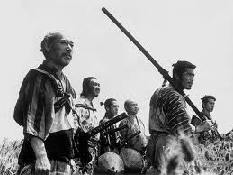
Rogue Faculty (Ronin in Japanese) Approach to Learner-Centric Delivery at WC
Case # 1: Founded on an underlying wiki system for diffusion of project and problem-based knowledge
Case # 2: Deployment of a wiki with blogging capability to replace Learning Management System in hybrid MBA course teaching Knowledge Mobilization (KMb)

Slide 5
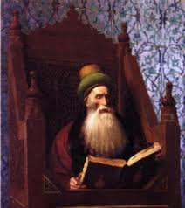
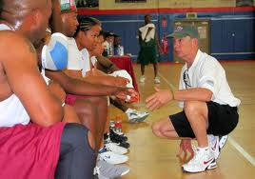
Mandate: Transform Learning Strategies and Learner Engagement
From ‘Sage on the Stage’
to ‘Guide on the Side’

Slide 6
Case Study # 1
Purpose:
Create a dynamic online repository for interaction by project-based BBA and MBA learners
bracket the experience in terms of the Community of Inquiry (CoI) framework
Qualitative Outcomes: [from CoI perspective]
Not reported here in detail, but the results included a qualitative sense of:
active project engagement (social presence)
Increased knowledge uptake through experiential learning (cognitive presence)
Instructor facilitation of teams, resulting in trust and commitment (teaching presence)

Slide 7
Case Study # 2
execute project-based activities, wiki-based techniques, and map theoretical KM material to pragmatic business problems during 7-week MBA courses teaching KM/KMb
bracket the experience in terms of the Community of Inquiry (CoI) framework
Coach’s observations and learners’ self-reported experiences describing an increased sense of:
self-reflection / active listening
intimacy / integrity
engagement / trust
Purpose:
Qualitative Outcomes:

Slide 8
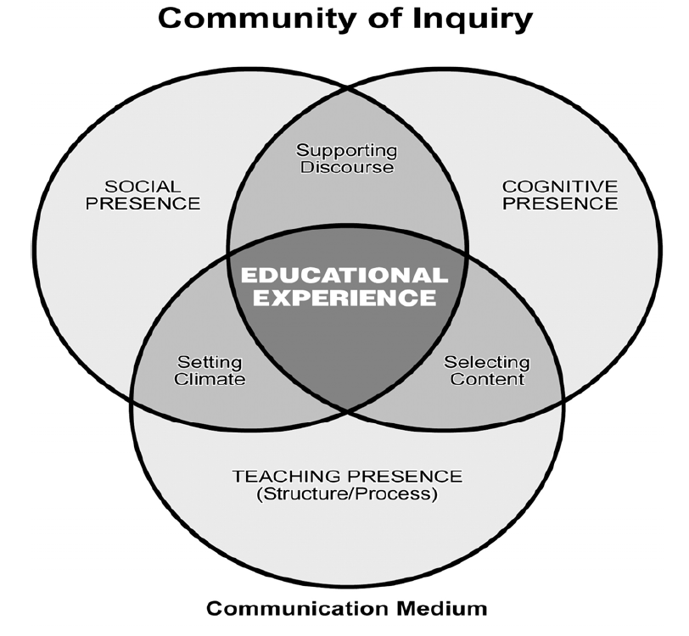
(CoI) Framework
Garrison, D. R. (2007). Online community of inquiry review: Social, cognitive, and teaching presence issues. Journal of Asynchronous Learning Networks, 11(1), 61-72.

Slide 9
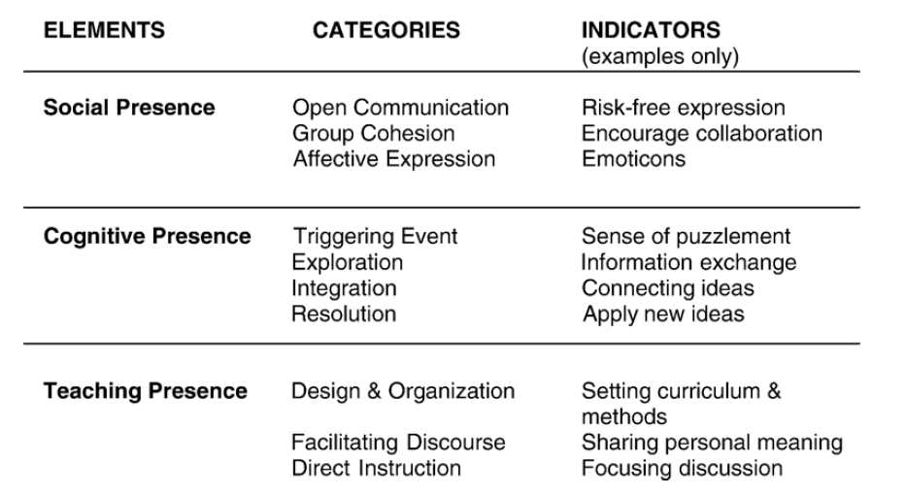
Detailed CoI Elements, Categories, & Indicators
From: Garrison, D. R., & Arbaugh, J. B. (2007). Researching the community of inquiry framework: Review, issues, and future directions. The Internet and Higher Education, 10(3), 157-172.

Slide 10
Course Environment [1]
(On Demand)
Team-based 7-week knowledge discovery project
Self-reflection blogs
Major Cases:

Slide 11
Team-based 7-week knowledge discovery project [1]
Simulated Organizational Setting:
High-tech firm, Mythical Wiki Software,.
Tiger Teams
The Challenge:
Competitors to Mythical Wiki Software

Slide 12
Team-based 7-week knowledge discovery project [2]
Goals:
Acquire, organize, catalogue, and report upon as much business intelligence as possible.
Identify unique and valuable methods for organizing the knowledgebase

Slide 13
Anatomy of an Experiment
Context: Confluence wiki used to focus:
experiential learning through hands-on uptake of the tool
knowledgebase of digital media
repository for learner-led presentations
Log of learner-led discussions
Blog of learner-authored personal reflection journals
Instructor took on coach leadership role

Slide 14
Overriding Question
Can the application of a wiki, (including the capability to blog) prove useful to induce an intense MBA classroom interaction experience and effect daily work practice, including personal reflection?

Slide 15
ABC Reflection Model for Learner Reflection Journals
Affect, Behavior, and Cognition reflective journal model (Welch, 1999) used to document adult learners’ reflective comments about:
their feelings about learning
subsequent changes in behavior
integration of knowledge and skills
Welch, M. (1999, Winter). The ABCs of reflection: A template for students and instructors to implement written reflection in service-learning. National Society for Experiential Education Quarterly, 25(2), 1, 23-25.

Slide 16
Coach’s Observations of Learners
Most learners actively engaged in the full range of topics, cases, and the discovery project
Most learners shared very intimate experiences from workplace situations as analogies to the problems encountered in the project
Most learners engaged in highly animated discussion
Most learners expressed that the presence of trust and integrity amongst the members developed exceptionally well during the seven weeks
Many learners started out very shy and within a couple of weeks were assertive and engaged in conveying their experiences and process outcomes through the wiki/blog tools
All learners stated that the intense team-based experience of this course had never occurred in any other MBA courses

Slide 17
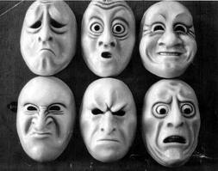
Learners’ ABC Reflection Self- Reflection
Affect
Behaviour
Cognition

Slide 18
Learner Journal Comments: Affect Dimension—Learner # 1
I feel confused, overwhelmed, and sympathetic.
As I began this course, I expressed my skepticism regarding the question “Can Knowledge Be Managed?”
Now, two weeks into the course, I have struggled with setting up all the technology components correctly.
I see how difficult it is to create a KM System; and why so many I have seen tend to fail.
My background is technical, but even from my perspective, I found it challenging and time-consuming … I see how this could be befuddling in any organization
The scope of KM can be daunting, as the World Bank Case demonstrated. Our small .. exercise feels intimidating to me, just after the first two weeks. I can only

Slide 19
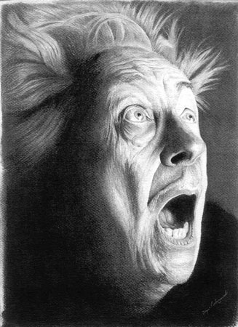
Learner Journal Comments: Behavior Dimension—Learner # 3
One of my hobbies is running. At first, running was the last thing I wanted to do.
It was painful and uncomfortable because I was not in very good aerobic shape.
I wanted to quit every day.
To me, putting theory into action can be just as uncomfortable and comparable to training for a race.
These same principles apply when it comes to improving and progressing as a KM practitioner.
The overall takeaway for me is to:
first, know yourself and what you can handle…
second, optimal progression comes as a result of gradual increases in training stress or in other words – don’t bite off more than you can chew…
[third] continually challenge yourself just enough that you're uncomfortable, but not hurting yourself.

Slide 20
Learner Journal Comments: Cognition Dimension—Learner # 5
People will make or break a KMb initiative.
To the extent that people are experiencing pain related to poor KMb…
Because people are so integral to the process of managing knowledge, I would say that while I believe knowledge management is possible it will be inherently difficult.
At a very high level I think this contributes to what makes managing knowledge so difficult.

Slide 21
Next Steps
Distribute, assess responses, and test the construct validity of the Community of Inquiry (CoI) Survey instrument for
Teaching Presence
Social Presence
Cognitive presence

