Slide 1
International Collaboration in the Cloud: from Michigan to New Zealand
Dr. Deanne Cranford-Wesley Davenport University
and
Dr. Krassie Petrova Auckland University

Slide 2
PURPOSE
To evaluate the success of a virtual learning session that involved international collaboration

Slide 3
METHODOLOGY
A service science based value creation approach based on the assumption that teaching and learning can be viewed as a value co-creation process that occurs during a teaching and learning event. The study is exploratory and measures success through the lens of perceived participant satisfaction.

Slide 4
CASE STUDY INFORMATION
The exploratory study presented here was designed to engage students in real-time learning, within a collaborative virtual learning session. A group of 16 students enrolled in a graduate Cloud Computing course took part in the study.
The course is part of the Master of Service Oriented Computing (MSOC) at AUT University, New Zealand and takes place over a 15 week semester. MSOC is offered by the School of Computing and Mathematical Sciences at the Faculty of Design and Creative Technologies which teaches an estimated 2000 students in various graduate and undergraduate technology oriented programs.

Slide 5
CASE STUDY INFORMATION
The virtual collaborative session included presentations on security issues in cloud computing. Two different perspectives were presented: an industry-oriented (AUT University), and an educational and research one (Davenport University).
The industry speaker was present in the classroom while the guest professor from Davenport University (the first author) utilized SM tools and appropriate technology (Skype™, Pamela Pro and a Webcam).
This session was recorded for future reflection from students and teachers. The students were able to see both instructors in real time, ask questions and get real time responses; they were assigned a related homework exercise facilitated by the second author.

Slide 6
CASE STUDY INFORMATION
After the presentations were concluded students were given an assignment to complete in class as an individual activity. The assignment was also formally assessed and contributed towards the students overall course grade.
The activity was a problem solving exercise based on a pre-assigned reading (Chen et al., 2011) that referred to security issues with storing data in the cloud.
Students were asked to consider the questions shown in italics in Figure 1, and provide answers. The assignment aimed to test student understanding of how the theory (security protocols) and the practice (cloud data storage) computing) worked together in the real world and how could the risks identified in the assignment questions could be successfully mitigated.

Slide 7
STUDENT ACTIVITY

Slide 8
RESEARCH MODEL

Slide 9
FINDINGS
The results of this exploratory qualitative study which attempted to gauge student perceptions and evaluate learning demonstrated a significant satisfaction level with the virtual collaborative session (overall mean across all questions 4.08, or 82%).
The result compares well with the overall student satisfaction across the school graduate computing programs (76%), and across the university (78%) as reported in the 2011 AUT student satisfaction survey [iii].
The mean of the responses to the question about future participation in similar sessions (81%) is also comparable to the mean of the responses to the question asking whether the respondent would recommend their course to others (84% across the university).

Slide 10
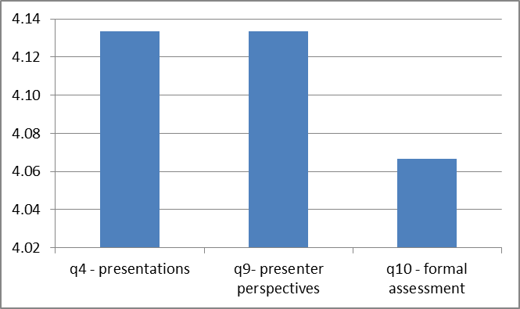
STUDENT SATISFACTION

Slide 11
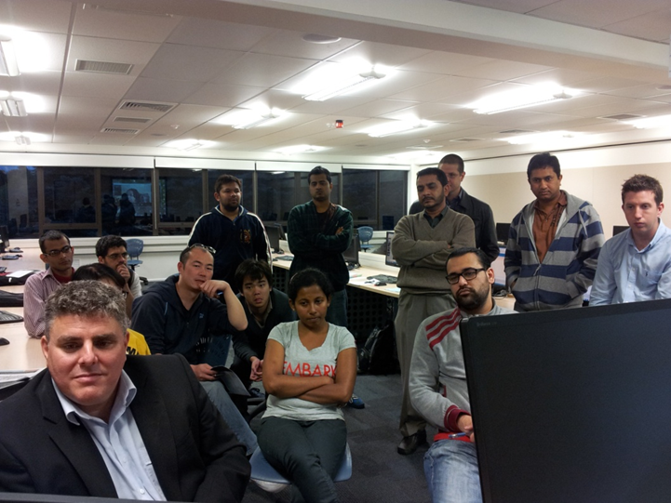

Slide 12
The only way of finding the limits of the possible is by going beyond them into the impossible. Arthur C. Clarke

